Slide 1

Hill AFB Trip Reduction Efforts
Dr. Erik Dettenmaier
Hill AFB Air Quality Program Manager
Jan 10, 2017

Slide 2
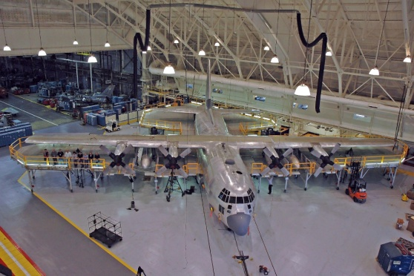
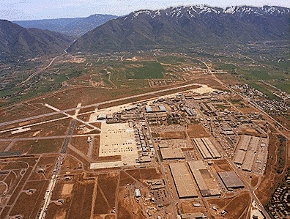
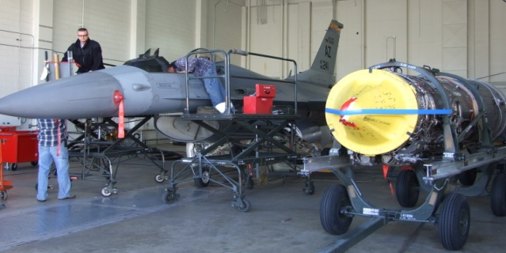
Hill Air Force Base Background
Large maintenance depot—2nd largest base
Over 21,000 employees
Largest single-site employer in Utah
Notes:
Air Force’s second largest base by population and geographic size
Employs more than 21,000 (this figure is from our mission video completed in March 2016 and probably better than the economic impact figure from FY 2016) military, civilian and contractor personnel

Slide 3
Civilian Flexible Work Schedules
Federal Employees Flexible and Compressed Work Schedules Act of 1982
Includes 5/4/9s and 4/10s
Approximately 80% of employees (16,000) work a flexible or compressed schedule:
  32,000-64,000 less trips/month
Notes:
Five/four/nines and four/tens
Participation rate:
I also spoke with our labor folks and to their knowledge, there no singular source for tracking employee shift schedules for the base as a whole. So there is no way of tracking that information without having to gather it from the supervisors of each section on base.
80% of 20K employees = 16K employees participate.
On the low end (if each participant works 5/4/9s, that’s 2 fewer trips per month) = 32K cars reduced per month (assuming everyone would be a single occupancy drive rate).
On high end (if each works 4/10s, that’s 4 fewer trips per month) = 64K cars reduced per month (assuming everyone would be a single occupancy drive rate).
.

Slide 4

Civilian Telework Program
Hill AFB Pilot Study began 2009
Air Force goal-increase participation by 1% each year
Currently 74 participants
Notes:
Pilot study source: “Telework – Is It Right for You and Your Organization?”, Hilltop Times article, publication date unknown.
AFI 36-816, Civilian Telework Program, 13 Nov 13:
Participation data:
We have approximately 74 employees actively teleworking at this time. I also spoke with our labor folks and to their knowledge, there no singular source for tracking employee shift schedules for the base as a whole. So there is no way of tracking that information without having to gather it from the supervisors of each section on base.

Slide 5
Civilian Telework Program
Program elements:
  Several eligibility requirements:
    Performance
    Safety
    Security
    Training
    Location
  Upon written agreement, employee responsible for most operating costs
  Saves travel time and costs, offers uninterrupted work environment
  Reduces traffic congestion and parking issues
Notes:
Situational teleworking covers medical conditions such as illness or injury and emergency home maintenance or repairs, inclimate weather, etc.
Employee responsible for operating costs of personally-owned equipment and home insurance, utilities, etc. Some office supplies/equipment may be covered like phone, internet, paper, toner, etc.
Requirements:
Eligibility: work must be portable, can’t depend on being at traditional work site, no classified work or security issues, can’t use as substitute for dependent care, work subject to supervisory oversight.
Performance: must meet or exceed successful performance standard
Self-certification safety checklist required, must report injuries in same manner as traditional work site.
Data security: covered by training, but no classified, protect FOUO, Privacy Act data, personal computers must comply with computer security requirements.
Training on data security, etc. must be completed.
Must designate one section of home as work station/alternate work site.
Must gain supervisory approval for situational, non-scheduled telework days.
Telework is not an entitlement, but a discretionary workplace flexibility.

Slide 6
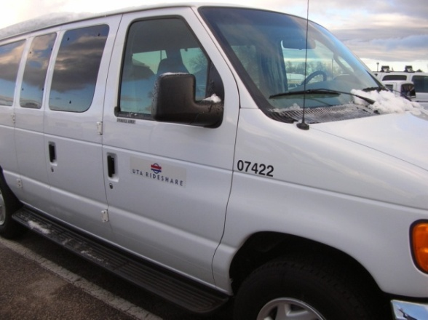
UTA Vanpool Program
Executive Order 13150 – Federal Transportation Incentive Program
Hill participation established in 2001
96 vans
747 participants
651 fewer vehicles on the road
  13,000 less trips/month
Notes:
Data sources: “Van Pools Add Convenience, Reduce Community Costs,” Hilltop Times, publication date unknown.
UTA Vanpool Support Specialist, Luwanna Fitzgerald
There are currently 96 vans commuting to Hill AFB carrying 747 participants. Reducing the potential of 651 more cars congesting Hill AFB base.
The furthest van South of Hill AFB comes from Orem Utah Valley 89.45 miles one way 133 minute commute
The furthest van North of Hill AFB comes from Malad Idaho 73.93 miles one way 72 minute commute
The benefits to ridesharing are the pollution savings: Year to date
Greenhouse Gases have been reduced by 4,101 million pounds
Non-renewable energy resources
Cost Savings: Gas, maintenance repairs & service, insurance, tires, tax savings. It all adds up.
Time Savings: Using the HOV lane on the expressway. Eliminating wait time at the security gates at Hill AFB. Time in personal vehicle locating a parking spot.

Slide 7
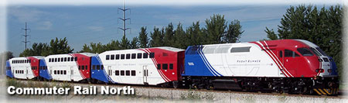
UTA Bus Service and FrontRunner
FrontRunner completed in 2008; 2013 base survey prompted negotiations with UTA for additional bus service
  Clearfield station 2 miles from base
2 routes added
Notes:
Data source: “Hill AFB Plans New Public Transit Service,” Hilltop Times, 6 Feb 14.

Slide 8
ECARS
Section 118(d) of Clean Air Act
Ensures vehicles driven on base meet local emissions standards
Federal employees only

